Slide 1
FLOOD MONITORING AND EARLY WARNING
Our project motive is to warn and inform people and other social platforms about the upcoming flood

Slide 2
The project involves deploying IoT sensors near water bodies and flood-prone areas to monitor water levels and provide early flood warnings through a public platform. The objective is to enhance flood preparedness and response by issuing timely warnings to both the public and emergency response teams. This project includes defining objectives, designing the IoT sensor network, developing the warning platform, and integrating them using IoT technology and Python.
DEFINITONS TO COVER:
Project Objectives: Define objectives such as real-time flood monitoring, early warning issuance, public safety, and emergency response coordination.
IoT Sensor Network Design: Plan the deployment of IoT sensors to monitor water levels in flood-prone areas.
Early Warning Platform: Design a web-based platform to display real-time water level data and issue flood warnings.
Integration Approach: Determine how IoT sensors will send data to the early warning platform.

Slide 3
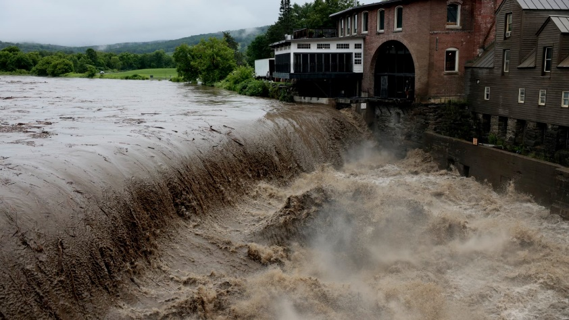
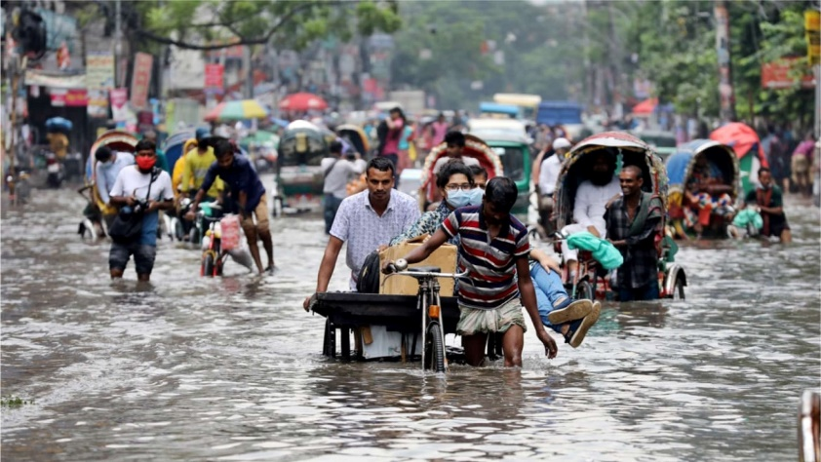
Project Objectives: Define objectives such as real-time flood monitoring, early warning issuance, public safety, and emergency response coordination.
HERE IN THIS PART WE WILL FIRST LIKELY TAKE STEPS TO IDENTIFY THE PREINFORMATION ABOUT THE ARRIVAL OF FLOOD PARTICULARY IN WHICH AREA IT IS GOING TO OCCUR OR ARISE .
AND ALSO WE WILL DETERMINE THE STRENGTH OF THE FLOOD AND MONITOR ITS STATUS USING THE ACCURATE SENSORS.

Slide 4
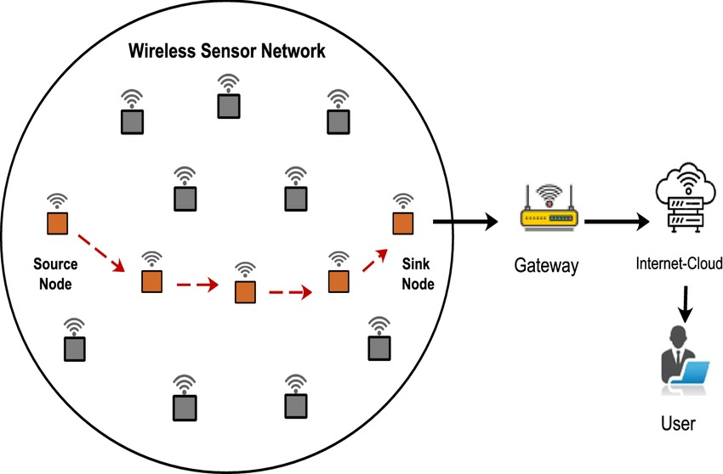

IoT Sensor Network Design: Plan the deployment of IoT sensors to monitor water levels in flood-prone areas.
AFTER THE BASIC KNOWLEDGE THE PLACEMENT OF SENSORS MUST BE DECIDED BY US.
3 SENSORS CAN BE USED
FIRST ONE IS VERYMUCH NEAR THE FLOOD ARISING AREA
SECOND ONE IS TO INTIMIDATE THE IMPACT AND AREA COVERED BY THE FLOOD
THIRD IS SAME AS 2ND , WHICH CAN BE USED TO DETERMINE IF 3RD SENSOR IS ACTIVATED THEN THE FLOOD COVERED THE LARGE AREA

Slide 5
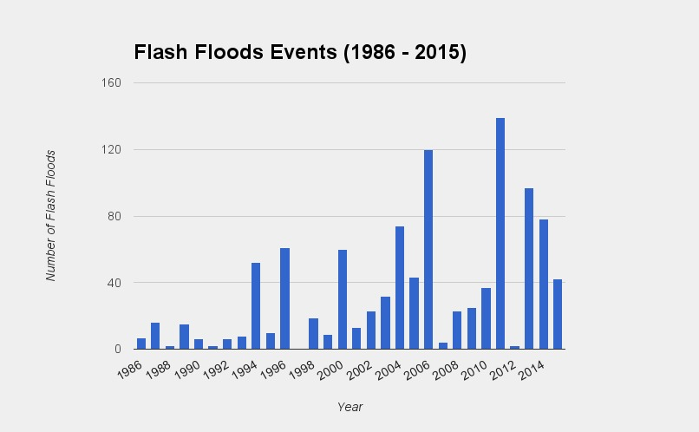

Early Warning Platform: Design a web-based platform to display real-time water level data and issue flood warnings.
THERE IS NO USE ONLY GETTING INFORMATION ABOUT FLOOD , IT MUST BE PASSED TO OTHERCITIZENS TO WARN THEM AT EARLY STAGE.
FOR THIS ,THE REAL TIME CONTINUOUS SIGNAL DATA OBTAINED FROM SENSOR MUST BE PASSED TO ALL THE CITIZENS AND THE AUTHORIZATION OF OUR COUNTRY.
IT CAN BE DONE USING A WEBBASED PLATFORM EITHER AS AN WEBSITE OR AN APP WHERE PEOPLE CAN ACCESS THE APPLICATION AND GET ENOUGH KNOWLEDGE ABOUT THE STATUS OF THE FLOOD .
BY THIS THE WARNING AND THE STATUS OF THE FLOOD CAN BE INFORMED AT AN EARLY STAGE.

Slide 6
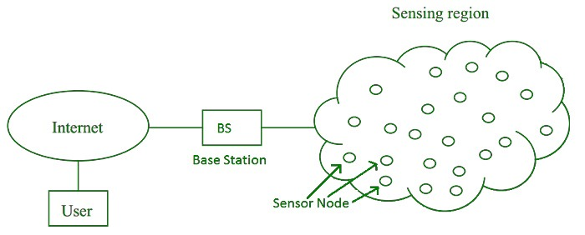

Integration Approach: Determine how IoT sensors will send data to the early warning platform.
The sensors will first collect data’s
About the flood disaster then it
will send the formation to the binded
website or the application which will
provide the necessary data and
information to the people and before
any unfortunate incidents occurred.
Firstly the information is collected as a data by the sensor .Secondly the collected information is sent to the media , and people ,etc . The second step is done by suing the website platform or and other media platform.

